Slide 1


Pablo Avila Segura
29 December 2024

Slide 2

Outline
Executive Summary
Introduction
Methodology
Results
Conclusion
Appendix

Slide 3
Executive Summary
Summary of methodologies
Data Collection through API
Data Collection with Web Scraping
Data Wrangling
Exploratory Data Analysis with SQL
Exploratory Data Analysis with Data Visualization
Interactive Visual Analytics with Folium
Machine Learning Prediction
Summary of all results
Exploratory Data Analysis result
Interactive analytics in screenshots
Predictive Analytics result

Slide 4
Introduction
Project Background and Context
SpaceX promotes Falcon 9 rocket launches on its website at a cost of $62 million, whereas other providers charge upwards of $165 million per launch. A significant portion of these savings is attributed to SpaceX's ability to reuse the first stage of the rocket. Consequently, by predicting the successful landing of the first stage, one can estimate the cost of a launch. This information is invaluable for any alternative company wishing to compete with SpaceX for rocket launch contracts. The primary objective of this project is to develop a machine learning pipeline capable of predicting the successful landing of the first stage.
Problems to Address
1. What factors influence the successful landing of the rocket?
2. How do various features interact to impact the success rate of a landing?
3. What operational conditions must be met to ensure a successful landing program?

Slide 5

Section 1

Slide 6
Methodology
Executive Summary
Data Collection Methodology:
The data for this project was sourced from two primary channels:
1. **SpaceX API**: Data was retrieved from the official SpaceX API, accessible at [https://api.spacexdata.com/v4/rockets/](https://api.spacexdata.com/v4/rockets/), providing detailed information on various rocket launches.
2. **Web Scraping**: Additional data was obtained through web scraping from Wikipedia's comprehensive list of Falcon 9 and Falcon Heavy launches, available at [https://en.wikipedia.org/wiki/List_of_Falcon_9_and_Falcon_Heavy_launches](https://en.wikipedia.org/wiki/List_of_Falcon_9_and_Falcon_Heavy_launches).
Data Wrangling:
The collected data underwent a thorough wrangling process to enhance its utility. This involved the creation of a landing outcome label, derived from the outcome data, which was summarized and analyzed to provide a clearer understanding of the factors influencing successful landings. The enriched dataset is now poised for further analysis and the development of predictive models.

Slide 7
Methodology
Executive Summary
The process of conducting an exploratory data analysis (EDA), performing interactive visual analytics, and executing predictive analysis using classification models is outlined as follows:
1. **Exploratory Data Analysis (EDA) using Visualization and SQL:**
- **Visualization:** Utilize data visualization tools such as Matplotlib and Seaborn to create plots and charts that provide insights into the data distribution, trends, and relationships. Common visualizations include histograms, scatter plots, box plots, and heatmaps.
- **SQL Analysis:** Employ SQL queries to explore the dataset, identify key statistics, and filter or aggregate data as needed. This involves querying the data for summary statistics, identifying missing values, and understanding the data structure.
2. **Interactive Visual Analytics using Folium and Plotly Dash:**
- **Folium:** Leverage Folium to create interactive maps that visualize geographical data points related to rocket launches. This can include mapping launch sites, trajectories, and landing zones to provide a spatial understanding of the data.
- **Plotly Dash:** Implement Plotly Dash to build interactive dashboards that allow users to explore and interact with the data dynamically. Dashboards can include various charts and graphs, sliders, and dropdowns to filter and visualize data in real-time.
3. **Predictive Analysis using Classification Models:**
- **Data Preparation:** Normalize the data to ensure it is on a consistent scale, and divide it into training and test datasets to facilitate model evaluation.
- **Model Selection and Evaluation:** Use four different classification models, such as Logistic Regression, Decision Trees, Random Forest, and Support Vector Machines (SVM), to predict landing outcomes or other target variables.
- **Parameter Tuning:** Evaluate the accuracy of each model by experimenting with different combinations of parameters. Techniques such as cross-validation and grid search can be employed to optimize model performance.
- **Model Comparison:** Compare the models based on their accuracy, precision, recall, and other relevant metrics to determine the most effective model for the data.
Through these steps, a comprehensive understanding of the data is achieved, and predictive insights are generated to inform decision-making processes.

Slide 8
Data Collection
The datasets were collected from two main sources: the SpaceX API and Wikipedia.
1. **SpaceX API:**
- Accessed via [https://api.spacexdata.com/v4/rockets/](https://api.spacexdata.com/v4/rockets/).
- Data was retrieved using HTTP GET requests, typically with Python libraries like `requests`.
- The API returned data in JSON format, which was parsed to extract relevant information such as rocket specifications and launch history.
2. **Wikipedia:**
- Data was extracted from the page [List of Falcon 9 and Falcon Heavy launches](https://en.wikipedia.org/wiki/List_of_Falcon_9_and_Falcon_Heavy_launches).
- Web scraping techniques, using tools like BeautifulSoup, were used to parse HTML tables for launch dates, payloads, and mission outcomes.
- The data was cleaned to ensure accuracy and consistency.
This approach provided a comprehensive dataset, combining technical details and historical launch information.

Slide 9
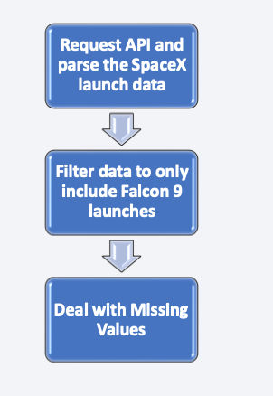
Data Collection – SpaceX API
SpaceX offers a public API from where data can be obtained and then used;
This API was used according to the flowchart beside and then data is persisted.
Source code: https://github.com/SouRitra01/IBM-Data- Science-Project/blob/main/Data%20Collection%20API.ipynb

Slide 10
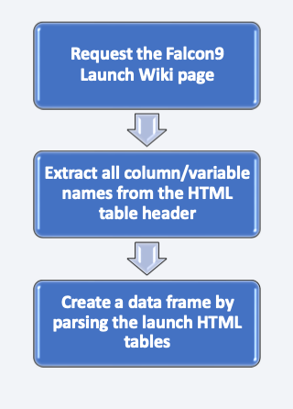
Data Collection - Scraping
• Data from SpaceX launches can also be obtained from Wikipedia;
• Data are downloaded from Wikipedia according to the flowchart and then persisted.
• Source code: https://github.com/SouRitra01/IBM-Data- Science- Project/blob/main/Data%20Collection%20wit h%20Web%20Scraping.ipynb

Slide 11
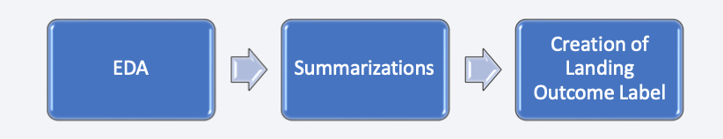
Data Wrangling
Initially some Exploratory Data Analysis (EDA) was performed on the dataset.
Then the summary launches per site, occurrences of each orbit and occurrences of mission outcome per orbit type were calculated.
Finally, the landing outcome label was created from Outcome column.
Source code: https://github.com/SouRitra01/IBM-Data-Science-Project/blob/main/Data%20Wrangling.ipynb

Slide 12
EDA with Data Visualization
The following SQL queries were performed:
Names of the unique launch sites in the space mission;
Top 5 launch sites whose name begins with the string 'CCA’;
Total pay load mass carried by boosters launched by NASA (CRS);
Average payload mass carried by booster version F9 v1.1;
Date when the first successful landing outcome in ground pad was achieved;
Names of the boosters which have success in drone ship and have payload mass between 4000 and 6000 kg;
Total number of successful and failure mission outcomes;
Names of the booster versions which have carried the maximum payload mass;
Failed landing out comes in droneship, their booster versions, and launch site names for in year 2015; and
Rank of the count of landing outcomes (such as Failure (droneship) or Success (ground pad)) between the date 2010-06-04 and 2017-03-20.
Source code: https://github.com/SouRitra01/IBM-Data-Science-Project/blob/main/EDA.ipynb

Slide 13
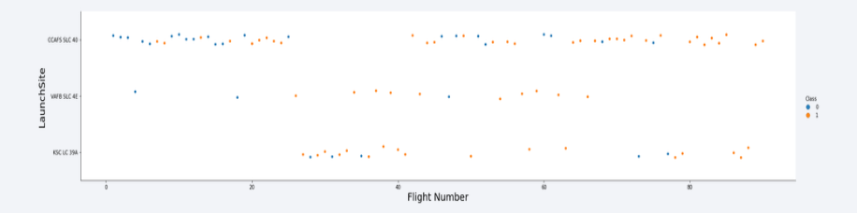
EDA with SQL
To explore data, scatterplots and bar plots were used to visualize the relationship between pair of features:
Payload Mass X Flight Number, Launch Site X Flight Number, Launch Site X Payload Mass, Orbit and Flight Number, Payload and Orbit
Source code: https://github.com/SouRitra01/IBM-Data-Science- Project/blob/main/EDA%20with%20Data%20Visualization.ipynb

Slide 14
Build an Interactive Map with Folium
Markers, circles, lines and marker clusters were used with Folium Maps
Markers indicate points like launch sites;
Circles indicate highlighted areas around specific coordinates, like NASA Johnson Space Center;
Marker clusters indicates groups of events in each coordinate, like launches in a launch site; and
Lines are used to indicate distances between two coordinates.
Source code: https://github.com/SouRitra01/IBM-Data-Science- Project/blob/main/Interactive%20Visual%20Analytics%20with%20Folium%20lab.ipynb

Slide 15
Build a Dashboard with Plotly Dash
We built an interactive dashboard with Plotly dash
We plotted pie charts showing the total launches by a certain sites
We plotted scatter graph showing the relationship with Outcome and Payload Mass (Kg) for the different booster version.
The link to the notebook is https://github.com/chuksoo/IBM-Data-Science-Capstone-SpaceX/blob/main/app.py

Slide 16
Predictive Analysis (Classification)
We loaded the data using numpy and pandas, transformed the data, split our data into training and testing.
We built different machine learning models and tune different hyperparameters using GridSearchCV.
We used accuracy as the metric for our model, improved the model using feature engineering and algorithm tuning.
We found the best performing classification model.
The link to the notebook is https://github.com/chuksoo/IBM-Data-Science-Capstone-SpaceX/blob/main/Machine%20Learning%20Prediction.ipynb

Slide 17
Results
The exploratory data analysis of SpaceX reveals the following:
1. **Launch Sites:** SpaceX uses four different launch sites.
2. **Initial Launches:** First launches were for SpaceX and NASA.
3. **Payload Capacity:** Falcon 9 v1.1 has an average payload of 2,928 kg.
4. **Successful Landings:** First successful landing occurred in 2015, five years after the first launch.
5. **Drone Ship Landings:** Many Falcon 9 versions successfully landed on drone ships with payloads above average.
6. **Mission Success Rate:** Almost 100% of missions were successful.
7. **Landing Failures in 2015:** F9 v1.1 B1012 and F9 v1.1 B1015 failed to land on drone ships in 2015.
8. **Improvement Over Time:** Landing outcomes improved as years passed.

Slide 18
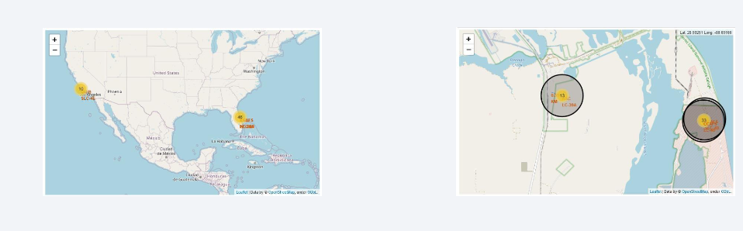
Results
Using interactive analytics was possible to identify that launch sites use to be in safety places, near sea, for example and have a good logistic infrastructure around.
Most launches happens at east cost launch sites.

Slide 19

Section 2

Slide 20

Flight Number vs. Launch Site
From the plot, we found that the larger the flight amount at a launch site, the greater the success rate at a launch site.

Slide 21


Payload vs. Launch Site
Payload vs. Launch Site

Slide 22

Success Rate vs. Orbit Type
From the plot, we can see that ES-L1, GEO, HEO, SSO, VLEO had the most success rate.

Slide 23

Flight Number vs. Orbit Type
The plot presented below illustrates the relationship between Flight Number and Orbit Type. It is evident that within the LEO orbit, success appears to be associated with the frequency of flights. Conversely, in the GTO orbit, there is no discernible relationship between the number of flights and the orbit.

Slide 24

Payload vs. Orbit Type
We can observe that with heavy payloads, the successful landing are more for PO, LEO and ISS orbits.

Slide 25

Launch Success Yearly Trend
From the plot, we can observe that success rate since 2013 kept on increasing till 2020.

Slide 26

All Launch Site Names
We used the key word DISTINCT to show only unique launch sites from the SpaceX data.

Slide 27

Launch Site Names Begin with 'CCA'
We used the query above to display 5 records where launch sites begin with `CCA`

Slide 28

Total Payload Mass
We calculated the total payload carried by boosters from NASA as 45596 using the query below

Slide 29

Average Payload Mass by F9 v1.1
We calculated the average payload mass carried by booster version F9 v1.1 as 2928.4

Slide 30

First Successful Ground Landing Date
We observed that the dates of the first successful landing outcome on ground pad was 22nd December 2015

Slide 31

Successful Drone Ship Landing with Payload between 4000 and 6000
We used the WHERE clause to filter for boosters which have successfully landed on drone ship and applied the AND condition to determine successful landing with payload mass greater than 4000 but less than 6000

Slide 32

Total Number of Successful and Failure Mission Outcomes
We used wildcard like ‘%’ to filter for WHERE MissionOutcome was a success or a failure.

Slide 33

Boosters Carried Maximum Payload
We determined the booster that have carried the maximum payload using a subquery in the WHERE clause and the MAX() function.

Slide 34

2015 Launch Records
We used a combinations of the WHERE clause, LIKE, AND, and BETWEEN conditions to filter for failed landing outcomes in drone ship, their booster versions, and launch site names for year 2015

Slide 35

Rank Landing Outcomes Between 2010-06-04 and 2017-03-20
We selected Landing outcomes and the COUNT of landing outcomes from the data and used the WHERE clause to filter for landing outcomes BETWEEN 2010-06-04 to 2010-03-20.
We applied the GROUP BY clause to group the landing outcomes and the ORDER BY clause to order the grouped landing outcome in descending order.

Slide 36

Section 3

Slide 37

All launch sites global map markers

Slide 38

Markers showing launch sites with color labels

Slide 39

Launch Site distance to landmarks

Slide 40

Section 4

Slide 41

Pie chart showing the success percentage achieved by each launch site

Slide 42

Pie chart showing the Launch site with the highest launch success ratio

Slide 43

Scatter plot of Payload vs Launch Outcome for all sites, with different payload selected in the range slider

Slide 44

Section 5

Slide 45

Classification Accuracy
The decision tree classifier is the model with the highest classification accuracy

Slide 46

Confusion Matrix
The analysis of the confusion matrix for the decision tree classifier indicates that while the classifier is capable of distinguishing between the different classes, there is a notable issue with false positives. Specifically, the classifier tends to incorrectly identify unsuccessful landings as successful ones. This misclassification could lead to an overestimation of the success rate, and addressing this issue is crucial for improving the model's accuracy and reliability. Consider refining the model or adjusting the decision threshold to mitigate these false positives.

Slide 47
Conclusions
1. **Flight Volume and Success**: More flights at a launch site correlate with higher success rates.
2. **Success Rate Increase (2013-2020)**: Launch success rates improved significantly during this period.
3. **Successful Orbits**: ES-L1, GEO, HEO, SSO, and VLEO orbits showed the highest success rates.
4. **KSC LC-39A's Excellence**: This site had the most successful launches among all sites.
5. **Decision Tree Classifier**: Identified as the best machine learning algorithm for this task.

Slide 48


